Slide 1

Big Data- Introduction

Slide 2

Contents
You will get knowledge on :
01
Big Data Definition
04
Addressing Pitfalls
02
How analytics is different in Big Data?
05
Big Data Architecture
03
Big Data : Pitfalls in Analysis
06
Mapping to our skill set

Slide 3
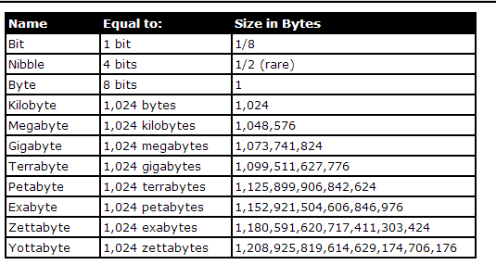
What is Big Data?
Why do we find hard to define Big Data formally?
One sentence define Big Data
“ Something that is huge”
Moving Target
Relative
Source: https://images.app.goo.gl/6q5oRZFkiazX6tar9

Slide 4
What can be called as Big Data Problem?
What other V’s Should be part of Big Data Problem?
Hypothetical Email Service
Volume
Velocity
Variety

Slide 5
What is Big Data?
Is it formalized?
Big Data” is data whose scale, diversity, and complexity require new architecture, techniques, algorithms, and analytics to manage it and extract value and hidden knowledge from it…

Slide 6
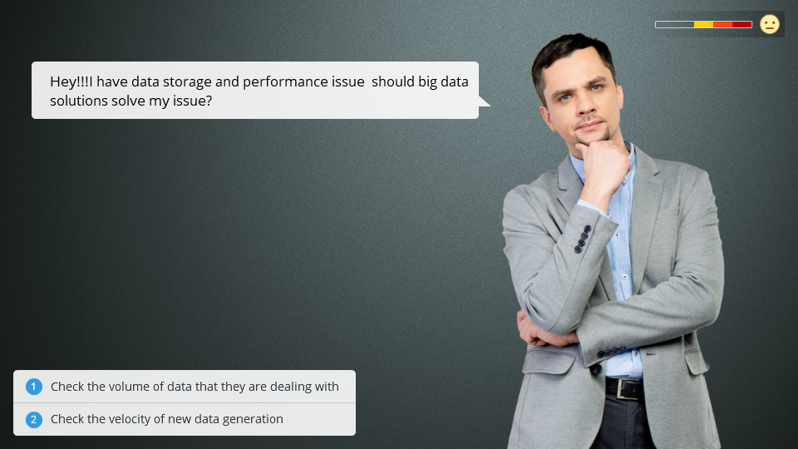

Slide 7

How analytics is different in Big Data?
Let's explore with a suitable use case

Slide 8

The way the analytics model is built
Man Vs Machine
Machine Translation
Translating a sentence from English to Hindi
What would be the traditional approach?
How will it differ from the Big Data approach?
https://towardsdatascience.com/intuitive-explanation-of-neural-machine-translation-129789e3c59f

Slide 9
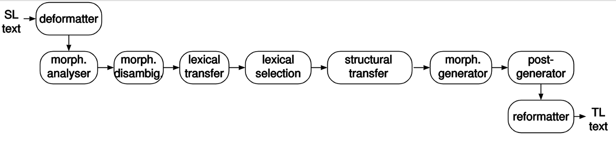
The way the analytics model is built
Man Vs Machine
Understand the system – linguistic approach – rule based
Requires a linguistic expert to build a model
Model should include
Language structure, morphology, grammar Meaning of the words
Mapping words from one language to another

Slide 10
The way the analytics model is built
Big Data
No attempt to understand language
Gather data about different sentences and translations
Requires a parallel corpus
Millions of sentences and their translations
Build a statistical model
For example:
Every time the word cat appears in the English sentence
The hindi equivalent has billi
So infer that cat can be translated as billi

Slide 11
BIG DATA
Big Data and Analytics
Input Data
Model
Analysis
Traditional Approach
The model is human generated
Big Data Approach
The model is machine generated

Slide 12
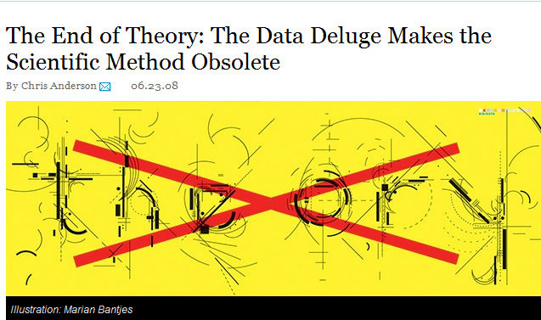
BIG DATA
What about domain knowledge?
Correlation is enough?
Gene sequencing of DNA fragments found in ocean by J. Craig Venter
1000s of new species
No idea of what species looks like or any other info
All models are wrong, and increasingly you can succeed without them
Peter Norvig, Google's research director
“The unreasonable effectiveness of data”
http://www.wired.com/science/discoveries/magazine/16-07/pb_theory

Slide 13
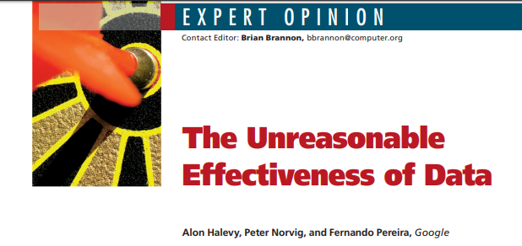
BIG DATA
Conclusions from Peter Norvig’s talk
Algorithms are not important, data is
Domain knowledge (e.g., physics/grammar) is not important
Demonstrates how images can be merged together using just data
And translation of text giving examples of issues in segmentation
Peter Norvig, Head Google Research, The Unreasonable Effectiveness of Data https://www.youtube.com/watch?v=yvDCzhbjYWs

Slide 14
BIG DATA
What about domain knowledge?
Can we rely only on data alone?
Does this mean that domain knowledge is obsolete?

Slide 15
Big Data: Pitfalls in Analysis

Slide 16
BIG DATA
Issues in machine translation
What about let the cat out of the bag?
Naïve translation - billi ko bag ke bahar chhod diya
English meaning: reveal a secret
To be able to solve this, we need information about the language, domain knowledge and some experimentation
Peter Norvig, Head Google Research, The Unreasonable Effectiveness of Data https://www.youtube.com/watch?v=yvDCzhbjYWs

Slide 17

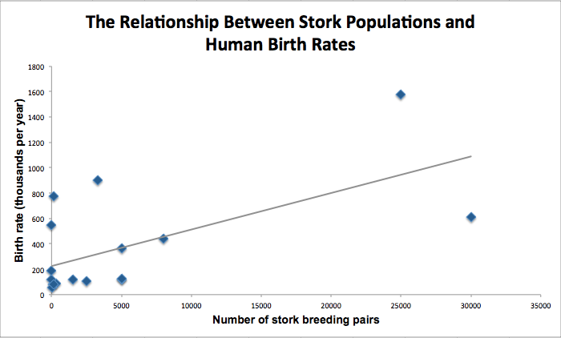
BIG DATA
Pitfall : Spurious correlation
C->A, C->B
Does A->B?
Example:
Do storks deliver babies?
Chart shows positive correlation between
Stork population and human birth rates in European countries
What it does not show is a hidden variable
Available nesting area?
http://en.wikipedia.org/wiki/Spurious_relationship
http://www.cut-the-knot.org/do_you_know/misuse.shtml

Slide 18
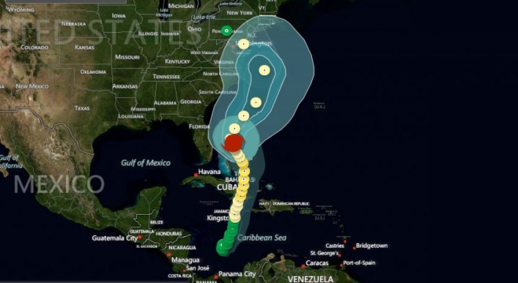
BIG DATA
Pitfall : Gaps in the data
Selection bias
Convenience
Example
Rutgers University study
Examine decision-making process in emergency
Study tweets during Hurricane Sandy
Most tweets from Manhattan!
If studying impact of Sandy: Manhattan most impacted!
More Data, More Problems: Is Big Data Always Right? ARI ZOLDAN http://www.wired.com/insights/2013/05/more-data-more-problems-is-big-data-always-right/

Slide 19

BIG DATA
Pitfall : Gaps in the data
Another example: medicine
Missing data is always a challenge
but we also know that “negative results” are more likely to go missing.
This means we have a biased sample, overestimating the benefits of treatments.
The Information Architecture of Medicine is Broken Ben Goldacre http://strataconf.com/strata2012/public/schedule/detail/22941
https://www.youtube.com/watch?v=AK_EUKJyusg

Slide 20
Big Data: How to address the issues?

Slide 21
BIG DATA
Summary of the methods
Use domain knowledge to check model for validity
Estimate errors

Slide 22
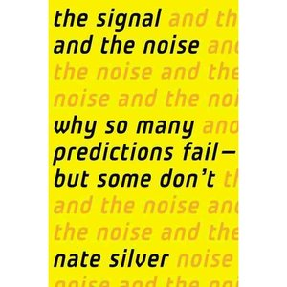

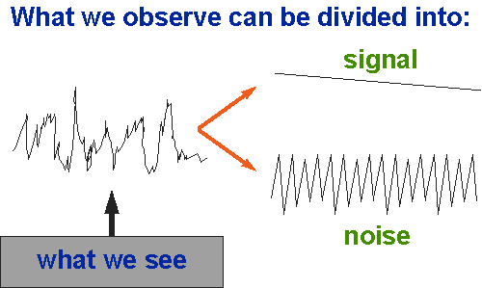
BIG DATA
Let’s look to some experts
Nate Silver book
The Signal and the noise
On Time Magazine 2009 – 100 most influential people
Correctly predict US 2008/2012 elections

Slide 23
BIG DATA
Example: Weather Forecasting
Why is weather forecasting very successful?
Chaotic (dynamic, non-linear system)
Lorenz: 29.5168 instead of 29.517
Adjustment by humans
Compute probabilities: how often predict rain, didn’t rain?
On ground reality
The effect of marketing/customer satisfaction in commercial weather forecasting.
More sensitive about errors in predicting no rain than rain
Notes:
Lorenz and his team were working to develop a weather forecasting program on an
early computer known as a Royal McBee LGP-30.21 They thought they were getting
somewhere until the computer started spitting out erratic results. They began with what
they thought was exactly the same data and ran what they thought was exactly the same
code—but the program would forecast clear skies over Kansas in one run, and a
thunderstorm in the next.
After spending weeks double-checking their hardware and trying to debug their
program, Lorenz and his team eventually discovered that their data wasn’t exactly the
same: one of their technicians had truncated it in the third decimal place. Instead of
having the barometric pressure in one corner of their grid read 29.5168, for example, it
might instead read 29.517. Surely this couldn’t make that much difference?
Lorenz realized that it could. The most basic tenet of chaos theory is

Slide 24
BIG DATA
Big Data Error Estimation
Purely empirical: cannot be analysed by theory
Divide data into training set and testing set
Develop algorithm using training set; estimate error from testing set
Can be used to compare analytics algorithms
Examples
Nate Silver: weather prediction: human adjustment
Amazon recommendations
Derive model using historical data; make recommendations
Get statistics on how many people look at or buy recommendations

Slide 25
Big Data: Summary and architecture

Slide 26
BIG DATA
Big Data themes
Large-Scale Data Management
How to manage very large amounts of data (data management)
and extract value and knowledge from them (analytics)
Google: store index to WWW and search
Amazon: store user purchases and make recommendations
Big Data Analytics
Data Science and Analytics

Slide 27
BIG DATA
Big Data and Analytics
Input Data
Model
Analysis
Big Data Pipeline
Data Consumption
Management
Data Processing
Data Storage
Data Ingestion/acquistion
Identifying data sources

Slide 28
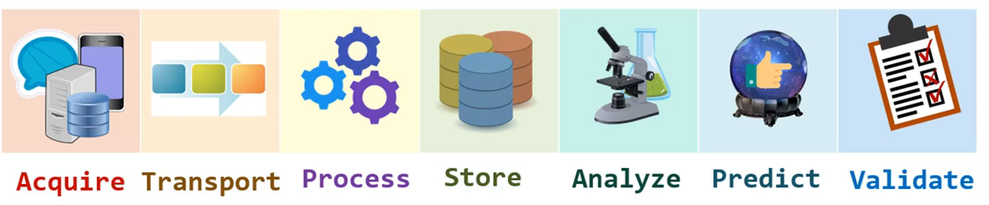
What is the designation given generally for this skill set?
Typical Data Flow Cycle
Data Engineering

Slide 29
THANK YOU

